Slide 1

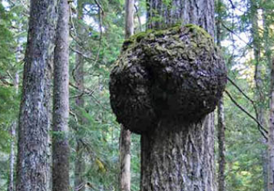
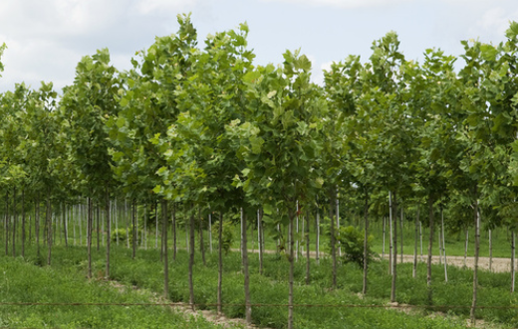
There are no problems, only opportunities
New product, process, service or information
WHICH CONDITION?
There are three main types of conditions your opportunity is in
Deviation to existing product, process, service or information
Improvement to existing product, process, service, or information

